Slide 1


<k.kubo>
<2023/12/21>

Slide 2

Outline
Executive Summary
Introduction
Methodology
Results
Conclusion

Slide 3
Executive Summary
Use SpaceX Rest API
Data Wraging
Get Data from SQL
Visualize Data
Build Map
Build DashBoard

Slide 4
Introduction
SpaceX advertises the launch cost of its Falcon 9 rocket at $62 million, which is considerably cheaper than the $165 million plus costs of other providers. The cost efficiency of SpaceX is mainly attributed to the reuse of the first stage. Predicting the success of landings can aid in estimating launch costs. This information is valuable for competitors aiming to secure rocket launch contracts in bidding wars against SpaceX.
Can we determine whether the first stage of Falcon 9 will successfully land using the provided data?

Slide 5

Section 1

Slide 6
Methodology
Executive Summary
Data collection methodology:
Using SpaceX Rest API
Perform data wrangling
Using API to get the data from json.
Perform exploratory data analysis (EDA) using visualization and SQL
Perform interactive visual analytics using Folium and Plotly Dash
Perform predictive analysis using classification models
Using Decision Tree Clasification.

Slide 7
Data Collection
In the data collection process, a combination of API requests from the SpaceX REST API and web scraping data from the tables on SpaceX's Wikipedia page was used.
Scraping of dates from the tables on SpaceX's Wikipedia page.
To obtain complete information about the launches for detailed analysis, both methods needed to be used.

Slide 8
Data Collection – SpaceX API
URL: https://github.com/kubooooooo/testrepo/blob/main/jupyter-labs-spacex-data-collection-api.ipynb
Request SpaceX API using get method
Save data as JSON format
Use pandas' json_normalize to convert data into a DataFrame
Filter Data to only include Falcon9 Launches

Slide 9
Data Collection - Scraping
URL:
https://github.com/kubooooooo/testrepo/blob/main/jupyter-labs-webscraping.ipynb
Get Wikipedia HTML using the requests library
Parsing HTML with BeautifulSoup
Extracts data in <table> tags
Convert data into data frames using the pandas library

Slide 10
Data Wrangling
URL:
https://github.com/kubooooooo/testrepo/blob/main/labs-jupyter-spacex-Data%20wrangling.ipynb
Calculating number of launches for each site
Calculating the number and occurrence of each orbit and mission outcome per orbit type
Create a landing outcome label from Outcome column
Exporting data to CSV

Slide 11
EDA with Data Visualization
Exploratory Data Analysis was conducted on variables such as flight number, payload mass, launch site, orbit, class, and year.
Scatter plots, line graphs, and bar charts were used to evaluate the relationships between variables and to ascertain their suitability for training machine learning models.
These visualizations were instrumental in determining the presence or absence of relationships between variables before incorporating them into the model training process. Analysis included the number of flights versus payload mass, number of flights versus launch location, payload mass versus launch location, orbit versus success rate, number of flights versus orbit, payload versus orbit, and the annual trend of success rate.
URL:
https://github.com/kubooooooo/testrepo/blob/main/jupyter-labs-eda-dataviz.ipynb.jupyterlite.ipynb

Slide 12
EDA with SQL
Collected data from IBM's cloud storage platform into a DataFrame and created SQL tables.
Utilized SQLite integrated with Python to perform EDA (Exploratory Data Analysis) for gaining valuable insights from the data.
Discovered information such as clear launch sites, specific entries related to particular launch sites, aggregations of different payloads, information about successful landings, and details regarding failed landings.
URL:
https://github.com/kubooooooo/testrepo/blob/main/jupyter-labs-eda-sql-coursera_sqllite.ipynb

Slide 13
Build an Interactive Map with Folium
Folium maps are effectively used for pinpoint visualization of key data such as launch and landing sites, distinguishing between successful and failed landings, and proximity to critical locations like railways, highways, coasts, and cities.
These maps serve as comprehensive visual tools to delve deeper into the rationale behind specific chosen launch locations.
By overlaying these significant locations with landing success spots, a clear correlation between these factors and successful landings can be discerned.
This visualization not only reveals geographical considerations affecting launch site placements but also provides valuable insights into strategic positioning relative to key infrastructure, aiding in the analysis of landing successes in relation to spatial context and proximity to these crucial features.

Slide 14
Build a Dashboard with Plotly Dash
Dashboard: Pie Chart Scatter Plot.
Choose to display a pie chart: Distribution of landing success rates at all rocket launch sites Success rates at individual launch sites. The scatter plot has two inputs: All sites or individual sites, and Payload mass on a slider ranging from 0 to 10000 kg. The pie chart is used to visualize the success rates of launch sites.

Slide 15
Predictive Analysis (Classification)
Splitting the Class Column
Using StandardScaler to standardize the data
Splitting the data into Train/Test variables
Using GridSearchCV for parameter tuning
Applying tuned parameters to LogReg, SVM, Decision Tree, KNN models
Scoring the models on the test set
Confusion matrices for all models
Comparing the scores of the models
URL: https://github.com/kubooooooo/testrepo/blob/main/SpaceX_Machine_Learning_Prediction_Part_5.jupyterlite.ipynb

Slide 16
Results
Exploratory data analysis results
Interactive analytics demo in screenshots
Predictive analysis results

Slide 17

Section 2

Slide 18
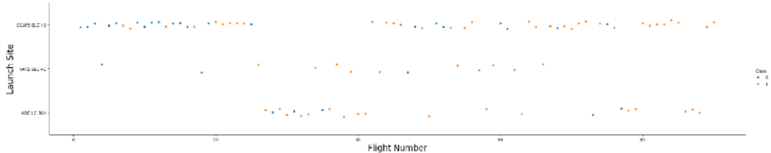
Flight Number vs. Launch Site
CCAFS SLC 40 has the highest number of Flight Numbers.

Slide 19
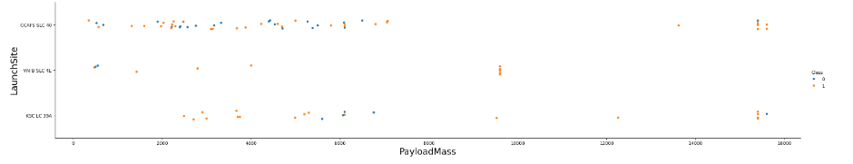
Payload vs. Launch Site
Looking at the scatter plot of payload versus launch site, it can be seen that at the VAFB-SLC launch site, rockets with a heavy payload mass (over 10,000) have not been launched.

Slide 20
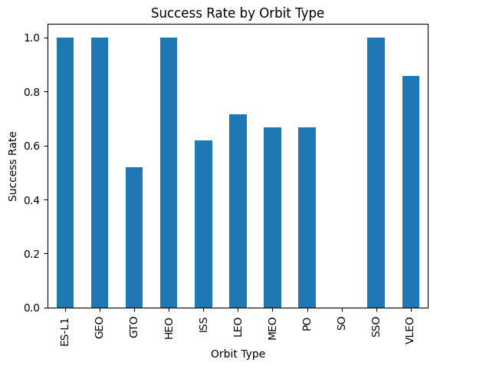
Success Rate vs. Orbit Type
Analyze the ploted bar chart try to find which orbits have high sucess rate.

Slide 21
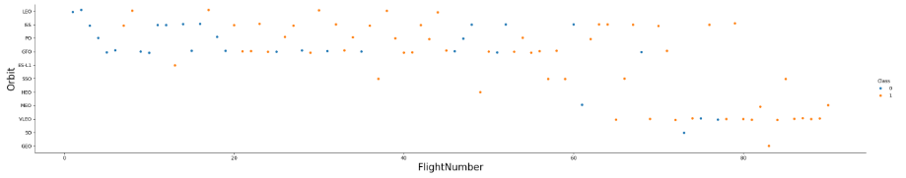
Flight Number vs. Orbit Type
In LEO orbit, success seems to be related to the number of flights, but in GTO orbit, there appears to be no relation to the number of flights.

Slide 22
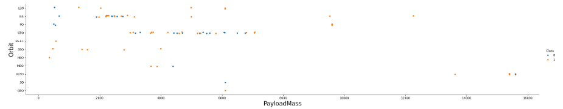
Payload vs. Orbit Type
With heavy payloads the successful landing or positive landing rate are more for Polar,LEO and ISS.

Slide 23
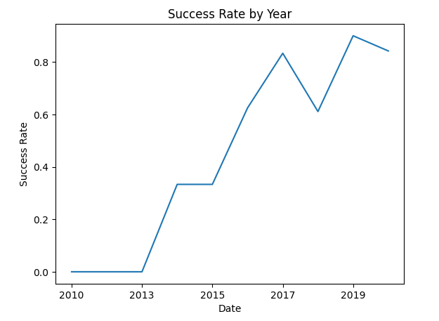
Launch Success Yearly Trend
From 2013 to 2020, the success rate has been steadily increasing.

Slide 24
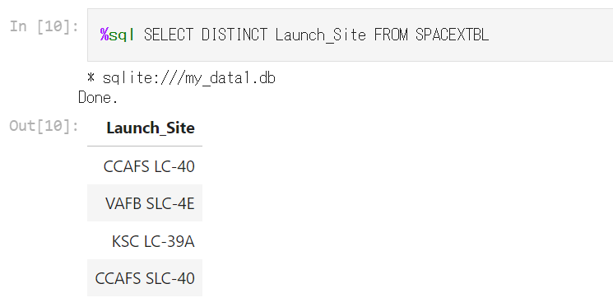
All Launch Site Names
Extract unique values from the 'Launch_Site' column using the DISTINCT method

Slide 25
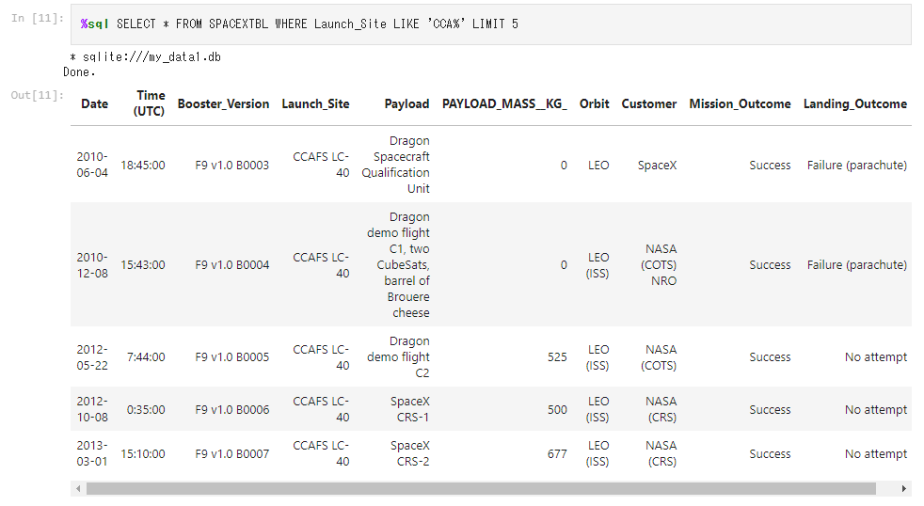
Launch Site Names Begin with 'CCA'
Select and display the first 5 rows from the SPACEXTBL table where the Launch_Site column starts with 'CCA’.

Slide 26
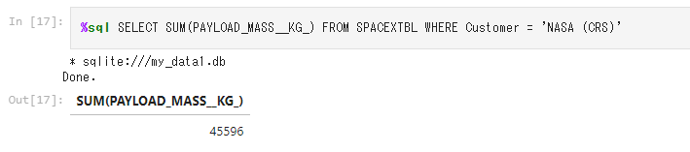
Total Payload Mass
Calculate the total sum (total payload mass) of the PAYLOAD_MASS__KG_ column values for all rows in the SPACEXTBL table where the value of the Customer column is 'NASA (CRS)'.

Slide 27
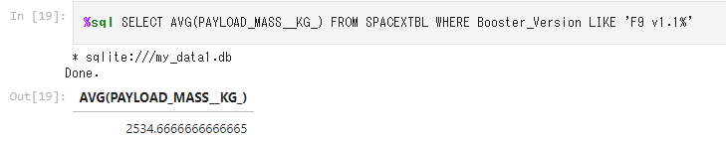
Average Payload Mass by F9 v1.1
Calculate the average (mean payload mass) of the values in the PAYLOAD_MASS__KG_ column for all rows in the SPACEXTBL table whose value in the Booster_Version column begins with 'F9 v1.1’.

Slide 28
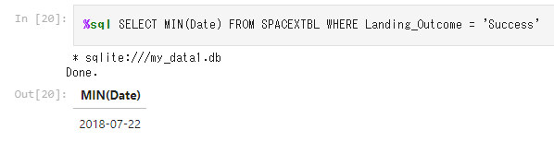
First Successful Ground Landing Date
Find the earliest date (the date of the first successful landing) among all rows in the SPACEXTBL table where the value of the Landing_Outcome column is 'Success' (successful landing).

Slide 29
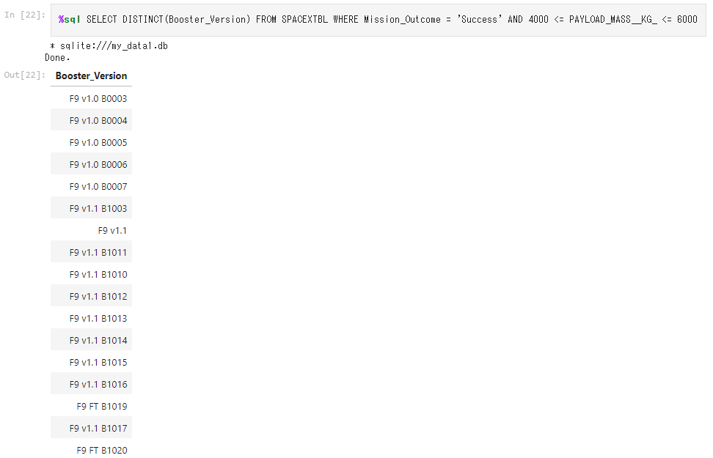
Successful Drone Ship Landing with Payload between 4000 and 6000
List all unique booster versions in the SPACEXTBL table that have a "successful" mission outcome and a payload mass in the range of 4000 kg to 6000 kg.

Slide 30
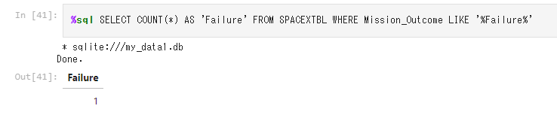
Total Number of Successful and Failure Mission Outcomes
Count the number of all rows in the SPACEXTBL table that contain 'Failure' in the Mission_Outcome column.

Slide 31
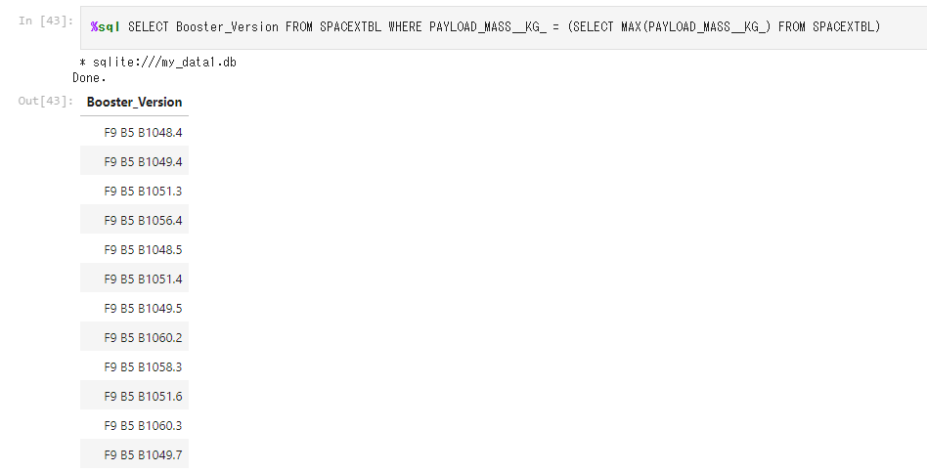
Boosters Carried Maximum Payload
Identify the booster version of the mission with the heaviest (largest) payload mass in the SPACEXTBL table.

Slide 32
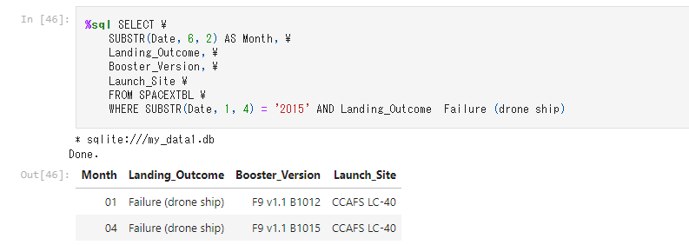
2015 Launch Records
Information on failed drone ship landing missions in 2015 (month, landing outcome, booster version, launch site) selected from the SPACEXTBL table.

Slide 33
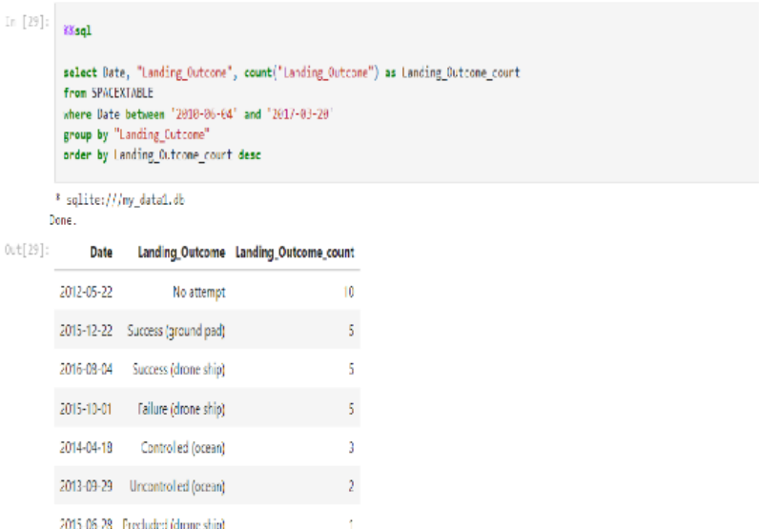
Rank Landing Outcomes Between 2010-06-04 and 2017-03-20
Rank the count of landing outcomes (such as Failure (drone ship) or Success (ground pad)) between the date 2010-06-04 and 2017-03-20,

Slide 34

Section 3

Slide 35
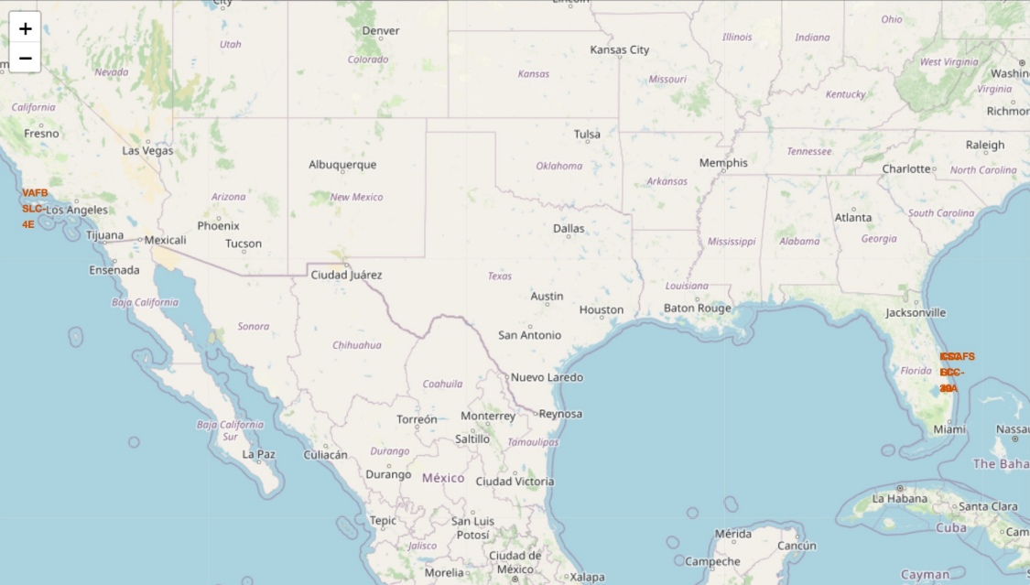
<All launch sites location markers on global map>
All launch sites in very close proximity to the coast

Slide 36
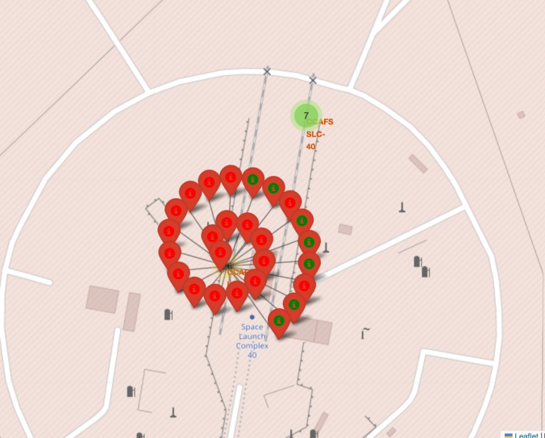
<Color-labeled launch outcomes>
the number of launches for each launch sites

Slide 37
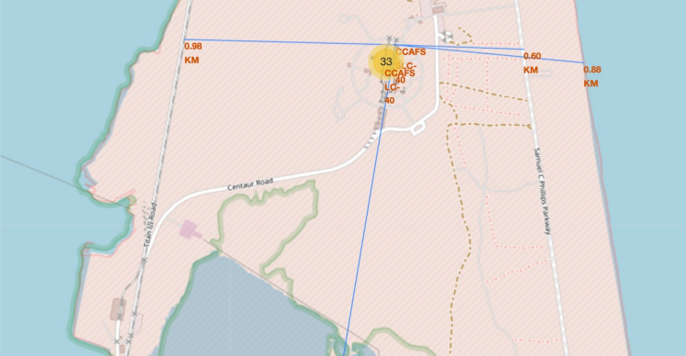
<Distance calculated to railway, highway, coastline>
The launch site is very close to railway, highway, and coastline

Slide 38

Section 4

Slide 39
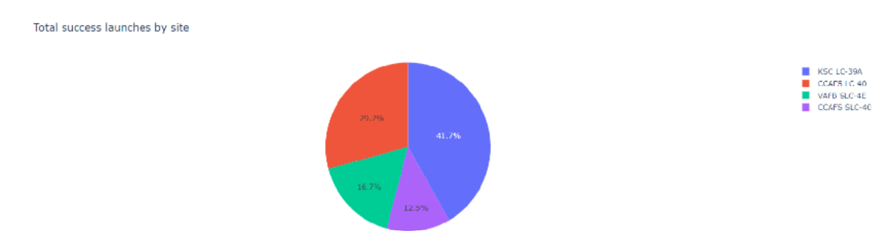
<Total Success Launches by Site>
KSC LC-39A has highest launches.

Slide 40
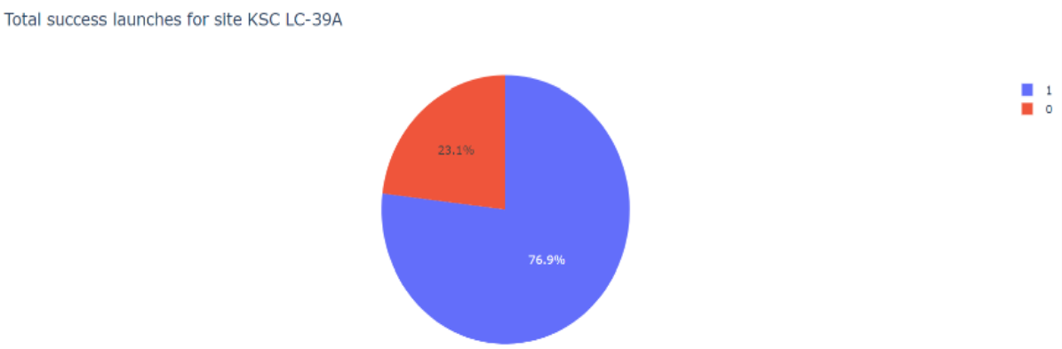
<Total Success KSC LC-39A>
KSC LC-39A has high score of total success.

Slide 41
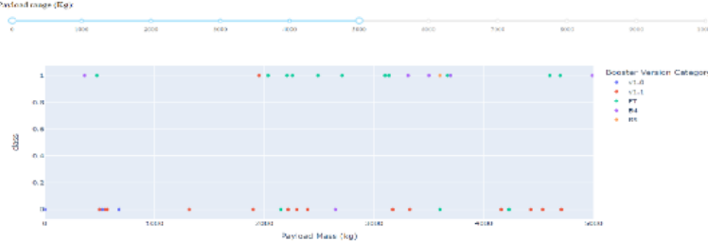
<Payload vs. Launch Outcome>
Payload and Lauch are greate factors from high score of total success.

Slide 42

Section 5

Slide 43
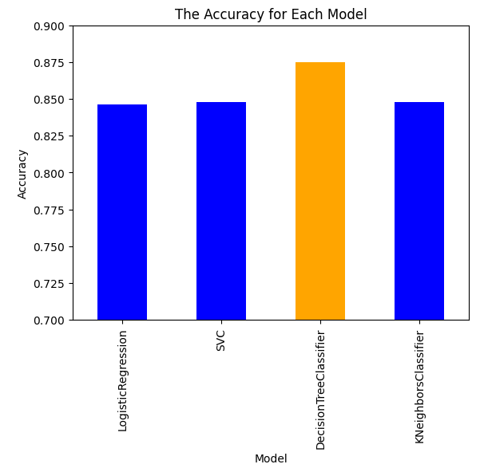
Classification Accuracy
The best model is the Decision Tree Classifier.

Slide 44
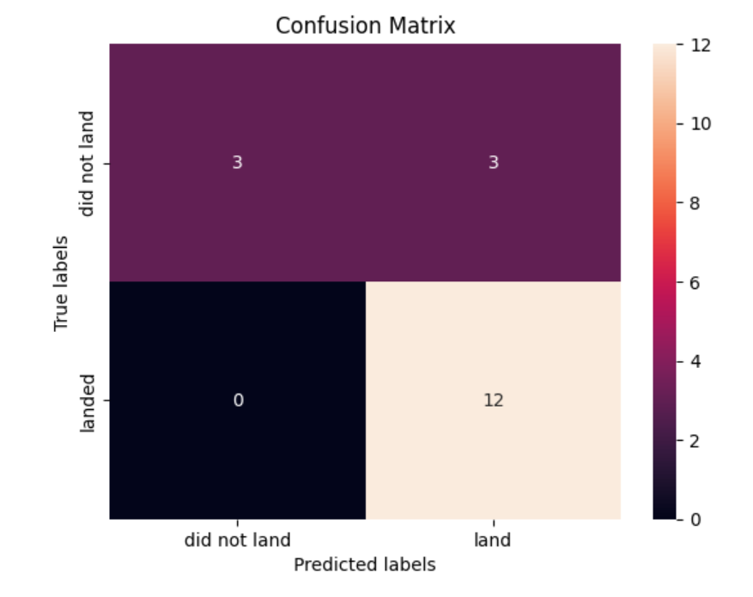
Confusion Matrix
The confusion matrix indicates the accuracy of the model.

Slide 45
Conclusions
Develop a machine learning model for SpaceY, who wants to bid for SpaceX.
To save a significant amount of money by predicting when Stage 1 will be successful.
Insufficient data was obtained to deem the model useful. Therefore, it is recommended to consider alternative approaches or wait for more data to arrive at a useful conclusion.

Slide 46


